Slide 1
START UP MANAGEMENT UNIT-1

Slide 2
TOPICS COVERED:
Definition of a start up,
features of a start up,
Lifecycle of a start up
difference between a start up and small business
issues & challenges , opportunities for a start-up
Entrepreneur & Intrapreneur
Formation of a start-up
Idea generation for a start-up -sources & techniques
Success factors for a start-up
Scaling-up process

Slide 3
Introduction to the term- START-UP
The term "start-up” has gained a lot of popularity these days. More and more individuals are interested in becoming entrepreneurs and therefore open their own business. Therefore, there are also more entities interested in helping new businesses.

Slide 4
EQUATION OF A start-up
New Business
Innovation
Technology
Passion
start-up

Slide 5
T H E Y A R E C R E A TIN G
D I S R U P T I O N

Slide 6

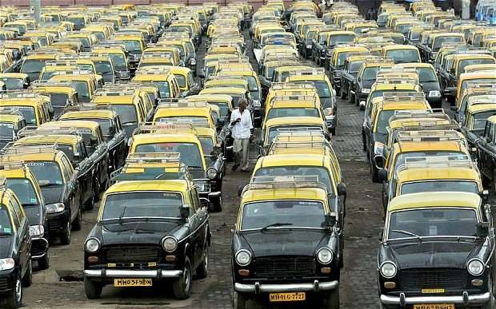

Disruption in Taxi Services
now
Then

Slide 7
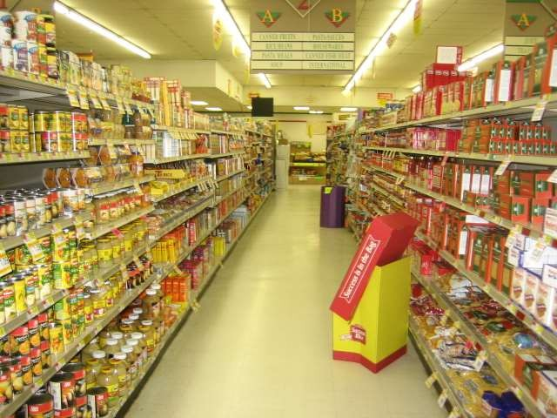

Disruption in Grocery
Then
now

Slide 8


Disruption in books
Then
now

Slide 9

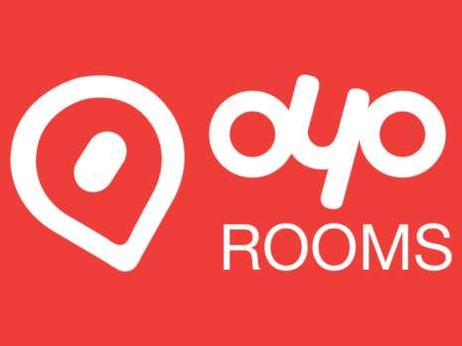
Disruption in Hotel Services
Then
now

Slide 10



Disruption in Shopping
Then
now

Slide 11



Disruption in eating places
Then
now

Slide 12












Disruption in Media

Slide 13


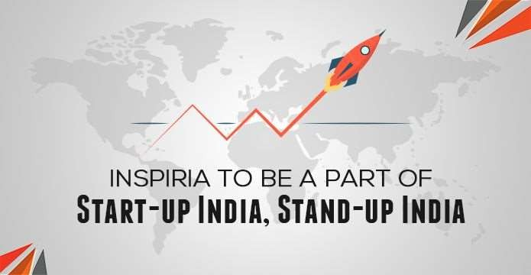
Start-up & stand-up India

Slide 14
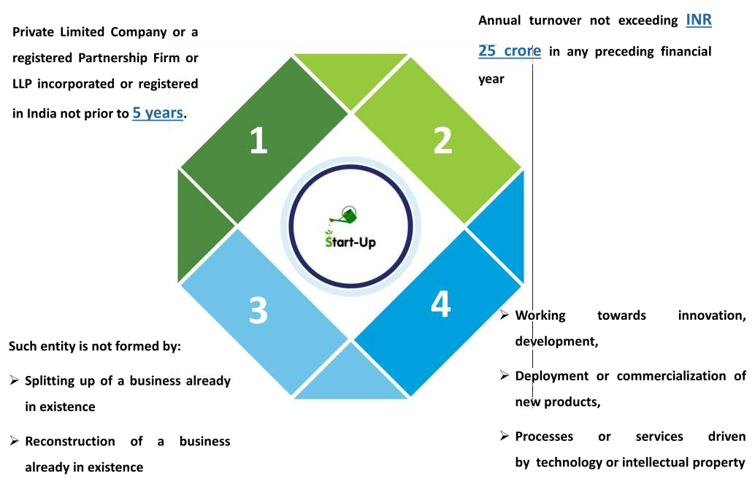
WHAT start-upS MEANS

Slide 15
START UP -DEFINITION
A start-up venture could be defined as a new business that is in the initial stages of operation, beginning to grow and is typically financed by an individual or small group of individuals.
It is a young entrepreneurial, scalable business model built on technology and innovation wherein the founders develop a product or service for which they foresee demand through disruption of existing or by creating entirely new markets.

Slide 16
A start-up business as an organization which is....
a) Incorporated for three years or less
b) An entrepreneurial venture/a partnership or a temporary business organisation
c) Engages in development, production or distribution of new products/services or processes
d) Revenue of up to INR 25 cr.
e) Not formed through splitting or restructuring
f) Employing 50 people or less

Slide 17
Department of Industrial Policy and Promotion (DIPP) define a start-up as an entity incorporated or registered in India with following parameters:
• Established not prior to seven years, (for Biotechnology start-ups not prior to ten years)
• With annual turnover not exceeding INR 25Cr in any preceding financial year, and
• Working towards innovation, development or improvement of products or processes or services,
• It is a scalable business model with a high potential of employment generation or wealth creation

Slide 18
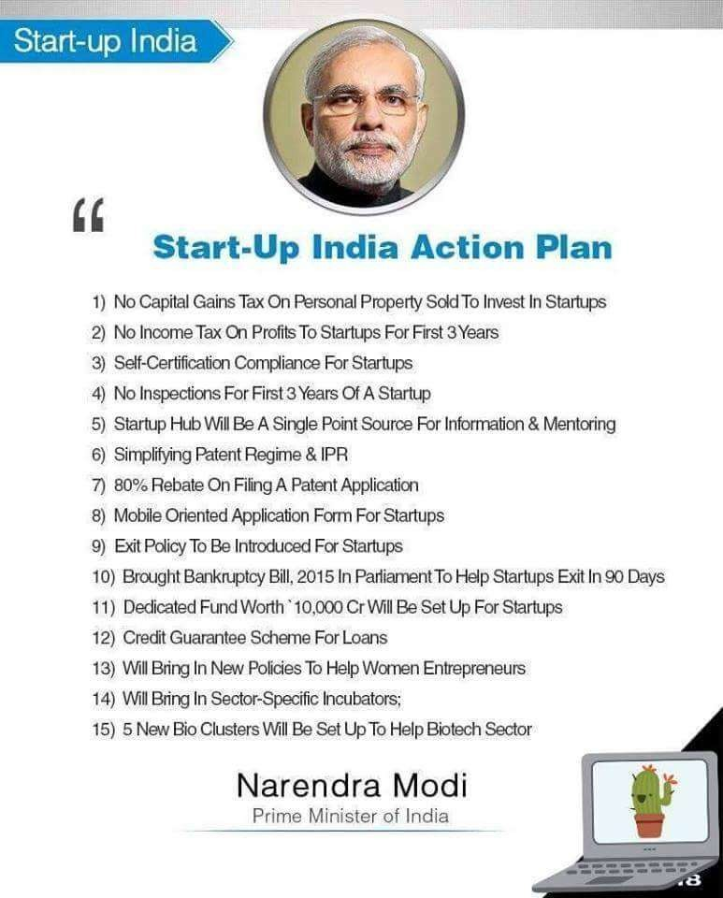
START UP INDIA
ACTION PLAN

Slide 19




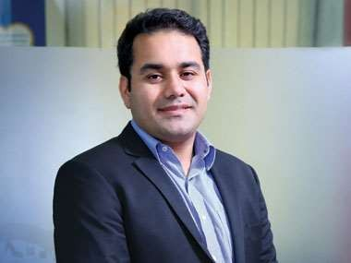


Best start-ups in India –They are young
Age : 37
Age : 35
Age : 31
Age : 28
Age : 21

Slide 20
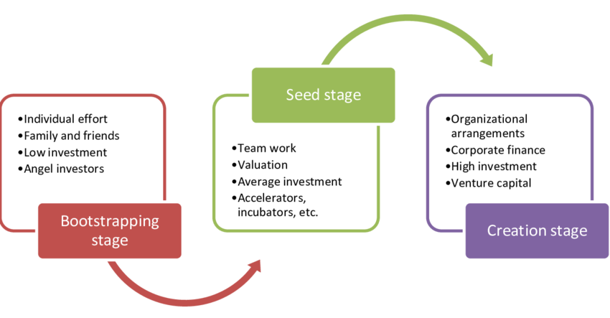
Start-up lifecycle

Slide 21
(i) Bootstrapping/ Self-funding stage:
The purpose of this stage is to position the venture for growth by demonstrating product feasibility, cash management capability, team building and management, and customer acceptance. Moreover, angel investors are more likely to invest in this stage.
In this very early stage, the entrepreneur himself/herself initiates a set of activities to turn his/her idea into a profitable business. However, he/she considers a higher risk or even uncertainty level, continues working on the new venture idea, makes a team, uses personal funds, and asks family members and friends for their investment in the idea.

Slide 22
(II) SEED STAGE
A great number of start-ups fail in this stage. Since they could not find support mechanisms and in best case they would turn to a low profit company with a low rate of success. On the other hand, those who succeed in receiving support would have a higher chance of becoming profitable companies. It goes without saying that valuation is normally done at the end of this stage.
This stage is characterized by team work, prototype development, entry into market, valuation of the venture, seeking for support mechanisms such as accelerators and incubators, and average investments to grow the start-up.

Slide 23
(iii) Creation stage:
At the end of this stage, organization/firm is formed and corporate finance is considered as the main choice for financing the firm. Venture capitals could facilitate the creation stage, by funding the venture.
This stage occurs when the company sells its products, enters into market, and hires first employees.

Slide 24
CHARACTERISTICS/FEATURES OF A START UP
Small scale organization
Technology driven
Young age
Passionate About Disruption
Have Product-Market Fit
Informal & Simple structure
Few differentiation
Centralized Ownership
Owner-manager

Slide 25
Continues.....
Intuitive decision making
Direct supervision
Strategy & Innovation
Niche marketing strategy
Prefer risky decision than the secure one
Fast innovation
First mover or second mover
Lack of product research
Financial Funding from personal savings or from relative

Slide 26
DIFFERENCE BETWEEN A START-UP & SMALL BUSINESS
A start-up venture is often misunderstood for simply a small new business. The truth is, there is a significant difference between a small business vs. start-up.

Slide 27

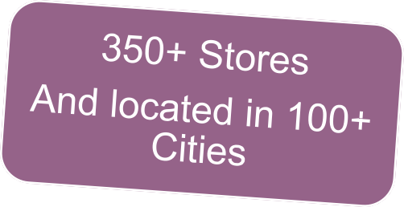
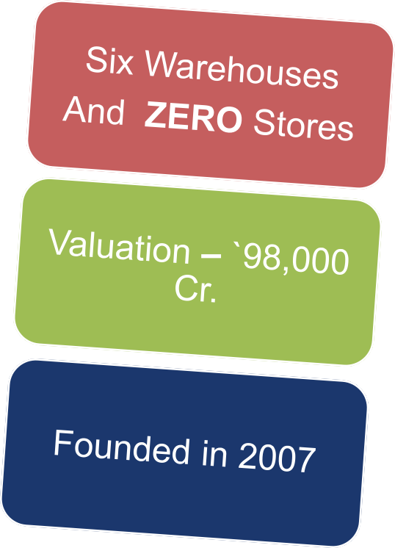
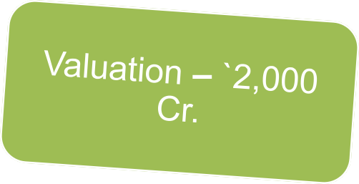


Slide 28

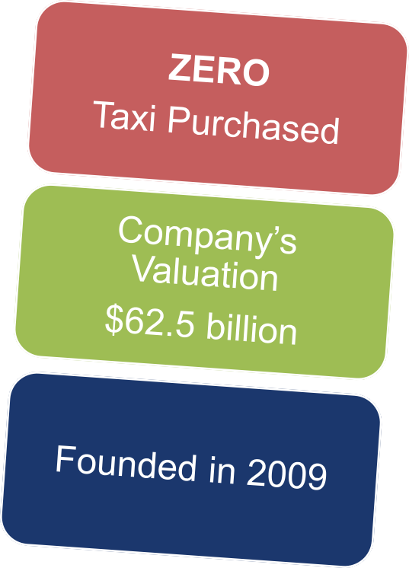
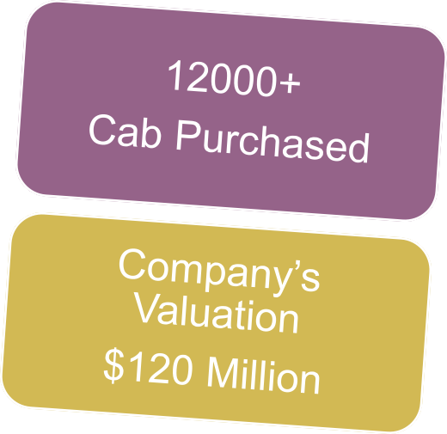

Slide 29
1. INNOVATION
Small business does not make any claims as to uniqueness. Your business is one out of many businesses alike (for example, hairdressing salon, restaurant, law office, blog/video blog etc.). Starting a business, you may easily follow out-of-the-box solutions.
Innovations are the most important things for a start-up. start-ups are meant to create something new and to improve what already exists. For instance, one may develop a new class of goods (wearable device), a new business model (Airbnb) or a technology no one knows as of yet (3D printing).

Slide 30
2. Scopes To what scopes your business will come up to?
Small business makes progress within limits established by a businessperson oneself. In other words, you put limitations on the growth of the company and focus on service of a certain circle of customers.
A start-up, as a rule, does not put any limitations on its growth and focused on winning over as much market share as possible. You are ready to increase your influence until you become a leader in the industry.

Slide 31
3. Rate of growth How fast will your business grow?
Small business, of course, should grow fast but a high-priority task is to make a profit. When a business opens benefits, its growth happens as and when necessary.
start-up should always grow and within the shortest possible time creating a reproducible business model. You should be able to reproduce the success of the company worldwide.

Slide 32
4. Profit How soon business will be paid off and how much it is possible to earn?
Small business is focused on getting earnings and, if possible, a profit from the very first day. A closing gain of the company depends on a chief`s appetites let alone plans for business expansion.
It might take months or even years for a start-up to gain first cents. A top target is to create a product, which consumers will like and will take on a market. If this aim will be achieved, profit of the company will be millions. (For instance, present evaluation of Uber company is 50 billion dollars).

Slide 33
5. Finance How much are you to invest?
start-up. Many projects are run by private means or with the help of family members and close ones. However, Financial borrowings from business angels, venture capitals, and investors remain the most common version.
start-up should reach out the stage of development, which is why it requires additional capital before the company begins making profits.
Small business. In order to start one’s own business, as a rule, private savings, investments on the part of one`s family, friends, banking credits and/or investor funds will do. However, your goal is to be self-sufficient, which is why you need to be attentive when it comes to contracting debts as long as all this money are to be returned someday with interest.

Slide 34
6. Technologies Are there any technologies used running a business?
Small business. There are no special technologies required. There are many out-of-box technological solutions, which are to be applied to achieve main business goals. Technologies in the sphere of marketing, accountant`s solutions, etc.
start-up. Technologies are oftentimes the main product of start-up. But even if it is not so, start-up cannot help but using new technologies to achieve fast growth and scale-up.

Slide 35
7. Lifecycle For how long will your business run?
Small business. 32% of enterprises are shut down in the first three years, which is not bad comparing to start-ups…
start-up. 92% of enterprises are shut down during the first three years.

Slide 36
8. Team and management How many workers are to hire?
For a small business as many workers are usually hired, as needed so a company operate within the established limitations of growth.
start-up manager should develop a leader and managing qualities from the very beginning as long as start-up should grow as fast as possible. As the company develops, you are to work with increasing amount of staff, investors, directors, and other concerned parties.

Slide 37
9. Way of life How your work and private life will be combined?
Small business, compared to start-ups, takes less of a risk and duties. Which makes it to where it is possible to combine work and personal life well enough. At the same time, a life of a businessperson is full of calls unknown for those who work 9AM-6PM. Thus, in a very elementary stage, any business will require high efforts. But in time work and personal life ratio has to to be balanced.
start-up. If there are investors` funds, the company will start making a profit earlier. Considering it, there is no time to lose. There are people next to you who wait until you create something unbelievable. So, a balance between work and personal life is out of the question. Work, work and work again!

Slide 38
10. Exit strategy What your business will end up with?
And the last one but not least in our list of main differences between start-ups and small business is exit strategy.
Small business. Two versions here: make it a family business or to sell it.
start-up. Usually moves towards next stage via a large deal on sale or IPO – Initial public offering.

Slide 39
Importance of a start-up
Innovations
New jobs and economic growth
Bringing new competitive dynamics into the economic system
Promoting the research-innovation system
Bringing the values of proactivity into the society

Slide 40
ISSUES AND CHALLENGES OF start-upS
Financial Resources:- A number of finance options ranging from family members, friends, loans, grants, angel funding, venture capitalists, crowd funding etc. are available. The requirement starts increasing as the business progresses. Scaling of business requires timely infusion of capital. Proper cash management is critical for the success of the start-ups.
Revenue Generation:- As the operations increase, expenses grow with reduced revenues forcing start-ups to concentrate on the funding aspect, thus, diluting the focus on the fundamentals of business. Hence, revenue generation is critical.
Team Members:- Assembling a good team is the first major requirement, failure to have one sometimes could break the start-up. According to a survey, 23 percent start-ups failed because members did not work as a team.

Slide 41
4. Supporting Infrastructure:- There are a number of support mechanisms that play a significant role in the lifecycle of start-ups which include incubators, science and technology parks, business development centers etc. Lack of access to such support mechanisms increases the risk of failure.
5. Creating Awareness in Markets:- start-ups fail due to lack of attention to limitations in the markets. The environment for a start-up is usually more difficult than for an established firm due to uniqueness of the product. The situation is more difficult for a new product as the start-up has to build everything from scratch
6. Exceed Customer Expectations:- the biggest challenge is the need to constantly reinvent the firm and come up with a service to be able to match up customer expectations and exceed them.

Slide 42
7. Tenacity of Founders:- Founders of start-ups have to be tough when the going gets tough. The journey of starting a venture is fraught with delays, setbacks and problems without adequate solutions. The entrepreneur needs to be persistent, persuasive, and should never give up till he/she achieves desired results.
8. Regulations :- Due to a maze of laws and regulations, it takes more of an effort for an entrepreneur to start a business in India than most of the other places in the world, and after he /she succeeds in setting up a business, it takes even a greater effort to comply with sector, department, state and center laws.
9. Growth Decelerators:- Some of the agencies which are part of the start-up ecosystem themselves can sometimes become hurdles in the growing stages as one of the major issues is the influence of incubators, institutes and similar organisations which try to control, manage and be the daddies of the start-ups in the name of helping, mentoring etc . This needs proper coordination among the organizations for mutual benefit.

Slide 43
10. Lack of Mentorship:- Most of start-ups have brilliant ideas and/or products, but have little or no industry, business and market experience to get the products to the market. Lack of adequate mentoring/guidance is the biggest challenge which could bring a potentially good idea to an end.
11. Lack of a Good Branding Strategy:- branding demands paramount attention as it gives an identity and occupies a space in the consumer minds.
12. Replicating Silicon Valley :- usually Indian start-ups get influenced by Silicon Valley models which may not succeed in Indian scenario. Lot of tweaking and modifications could be required when transplanted into Indian markets keeping in mind Indian infrastructure in terms of roads, internet, electricity and telecom penetration.

Slide 44
OPPORTUNITIES
I. INDIA’S LARGE POPULATION :The population of India is a huge asset for the country. By 2020, it is expected that the working age population would surpass the non-working population. This unique demographic advantage will offer a great opportunity to any start-up. Various infrastructure issues and the bottom- of- thepyramid market would provide huge opportunities for the start-ups.
II. CHANGE OF MIND SET OF WORKING CLASS Traditional career paths will be giving way to Indian start-up space. Challenging assignments, good compensation packages would attract talented people to start-ups. Also, it is seen that several high profile executives are quitting their jobs to start or work for start-ups. To reinforce the trend being seen, a survey conducted by Economic Times also confirmed that the number of students joining start-ups and e-commerce companies has grown considerably in the recent years (Anand, 2016)
III. HUGE INVESTMENTS IN start-upS Huge investment in Indian start-ups from foreign and Indian investors is taking place. In 2015, more than 300 deals were done by 300+ angels and venture capital/ private equity players with around $6.5-billion (Rs 42,300Cr) investments making India the most sought after destination for investments.

Slide 45
IV. GOVERNMENT INITIATIVES There are numerous government and semi-governmental initiatives to assist start-ups.
• Start-Up India This initiative provides three-year tax and compliance breaks intended for cutting government regulations and red tapism.
• MUDRA Yojna Through this scheme, start-ups get loans from the banks to set up, grow and stabilize their businesses.
• SETU (Self-Employment and Talent Utilization) Fund Government has allotted Rs 1,000 Cr in order to create opportunities for self-employment and new jobs mainly in technology-driven domains.
• E-Biz Portal Government launched e-biz portal that integrates 14 regulatory permissions and licenses at one source to enable faster clearances and improve the ease of doing business in India.
• Royalty Tax Indian government has reduced the royalty tax paid by businesses and start-up firms from 25per cent to 10 per cent

Slide 46
V. INVESTMENTS BY BIG BUSINESS HOUSES
Big business houses are already investing in start-ups as they cannot use their infrastructure to concentrate on small outfits like start-ups which require different skill-sets. Industrialists like Ratan Tata (Ola, Bluestone etc), Azim Premji (DataStax,Myntra etc) and many more are investing in start-ups giving desired traction and respectability to the segment

Slide 47
ENTREPRENEUR & INTRAPRENEUR
An entrepreneur is an individual who conceives the idea of starting a new venture, take all types of risks, not only to put the product or service into reality but also to make it an extremely demanding one. He is someone who:
Initiates and innovates a new concept,
Recognises and utilises opportunity,
Arranges and coordinates resources such as man, material, machine and capital,
Take suitable actions,
Faces risks and uncertainties,
Establishes a start-up company,
Adds value to the product or service,
Takes decisions to make the product or service a profitable one,
Is responsible for the profits or losses of the company.
Entrepreneurs are always the market leader regardless of the number of competitors because they bring a relatively new concept in the market and introduce change.

Slide 48
Definition of Intrapreneur
An intrapreneur is nothing but an entrepreneur within the boundaries of the organisation.
An intrapreneur is an employee of a large organisation, who has the authority of initiating creativity and innovation in the company’s products, services and projects, redesigning the processes, workflows and system with the objective of transforming them into a successful venture of the enterprise.
The intrapreneurs believe in change and do not fear failure, they discover new ideas, looks for such opportunities that can benefit the whole organisation takes risks, promotes innovation to improve the performance and profitability, resources are provided by the organisation. The job of an intrapreneur is extremely challenging; hence they are appreciated and rewarded by the organisation accordingly.
From last few years, it has become a trend that large corporations appoint intrapreneur within the organisation, to bring operational excellence and gain competitive advantage.

Slide 49
BASIS FOR COMPARISON | ENTREPRENEUR | INTRAPRENEUR
Meaning | Entrepreneur refers to a person who set up his own business with a new idea or concept. | Intrapreneur refers to an employee of the organization who is in charge of undertaking innovations in product, service, process etc.
Approach | Intuitive | Restorative
Resources | Uses own resources. | Use resources provided by the company.
Capital | Raised by him. | Financed by the company.
Enterprise | Newly established | An existing one
Dependency | Independent | Dependent
Risk | Borne by the entrepreneur himself. | Taken by the company.
Works for | Creating a leading position in the market. | Change and renew the existing organizational system and culture.

Slide 50
Google
Google is a company that embraces intrapreneurship by offering their workforce a 20 per cent timeframe on developing personal projects relating to the business. One such project from Paul Buchheit was the initial template for Gmail, particularly the search function (the first of its kind from email service providers) and increased storage capacity.
Today, Gmail remains one of the most widely-used email platforms on the web; driving key traffic to Google’s products. And all thanks to the brainchild of one of their employees.

Slide 51
Benefit: Paul Buchheit, the creator of Gmail, started on the project in 2001 and worked up to its launch on April 1, 2004 (April Fools but not really.) Gmail became the first email with a successful search feature and the option to keep all of your email (hello 1GB of storage) instead of frantically deleting to stay under your limit. The initial launch was by invite only, quite the hot commodity. Now, it’s considered a faux pas not to have an email address ending in @gmail.com.

Slide 52
FORMATION OF A START-UP
1. Do your market research
Conducting market research is the first step to determine if you really do have an idea worth pursuing. Begin your research by writing down what you think the problem is that your business idea would be solving. Physically write it down and keep it in front of you.
2. Secure intellectual property
Intellectual property (IP) refers to the process by which an individual or company can own the rights to a created product. Examples include patents, copyright, and trademarks. It is vital to the success of your company that you follow the proper protocol to protect your differentiating factor.

Slide 53
3. Decide on branding
Branding is about more than just choosing a name, it's about deciding on an identity for your idea. You want to choose something you love, but you also want to choose a name that conveys the experience of using your product and the problem that it solves.
4. Incorporate
Incorporating is a big deal for a startup because there are so many aspects of the startup lifecycle that affect it, and are affected by it. Incorporating is the process of turning your business into a legal entity and deciding how it will be structured.

Slide 54
5. Choose a co-founder
Not having the proper support for even the best of ideas can kill your execution. In fact, some investors look at the founding team first before looking at the idea when considering making an investment. If you have a co-founder already -- awesome. If not, you should consider bringing someone else into the fold.
6. Write a business plan
One way to set your startup off on the right path is to write a good business plan. Using the market research you did earlier, create your plan of attack and decide what you want to accomplish with your new business. Determine goals and milestones, and what steps you need to make it to those milestones.

Slide 55
7. Pick a workplace
Where you work actually does have an effect on your startup as you're getting off the ground. Different environments will suit different working styles best. Many founders choose to work from home initially to save money, but others choose to rent at a coworking space, share an office, or rent and office for themselves. Don't be afraid to experiment, but don't let the search for the perfect space get in the way of your work.

Slide 56
8. Find a mentor
Mentorship is a touchy subject. First, you should determine if having a mentor is good for you as a founder. If so, finding the right mentor can make a huge difference. Even with the combined expertise of you and your co-founder, a mentor can provide deep industry insight and wisdom to help you navigate some of the challenges that come your way.
9. Apply for an accelerator program
If you need some additional resources and expertise, consider applying for an accelerator. An accelerator is a program for startup businesses that helps speed the growth of the company by providing a mentor network and sometimes a small investment. These programs can also give their companies the opportunity to formally pitch the media and other members of the startup community during a demonstration day at the end of the program.

Slide 57
10. Raise capital
For many startups, taking it to the next level requires a financial investment in the company. Founders give equity in their company to angel investors or venture capital investors in return for money and, sometimes, advice. The resources can be an enormous help, but taking capital investments does have a dark side that should be understood before you move forward.
If you need to raise capital for your business, you should begin by deciding how much money to raise and how it will affect your startup. Once you have that figured out, you should decide how you'll be raising it -- by crowdfunding, from an angel investor, or through a traditional VC firm. Then, you need to practice your pitch.

Slide 58
IDEA GENERATION TECHNIQUES
1. Role Playing: Role playing involves designers acting out scenarios. These scenarios are often ones that the designers observed during the research phase of the design process when they participated in user research. This technique is a tool for both team-based ideation and communication to users and/or clients
2. Active Search: Active search refers to designers hunting for a particular solution. This hunt could range from a web search for images of current vacuum cleaners to searching through books, magazines, newspapers, etc. to find the demographics of a particular population
3. Attribute List: Attribute listing refers to taking an existing product or system, breaking it into parts and then recombining these to identify new forms of the product or system
4. Brainstorm: Brainstorming involves generating a large number of solutions to a problem (idea) with a focus on the quantity of ideas. During this process, no ideas are evaluated; in fact unusual ideas are welcomed. Ideas are often combined to form a single good idea Brainstorming can be used by groups as well as individuals

Slide 59
5. Collaborate: Collaboration refers to two or more people working together towards a common goal .Designers often work in groups and co-create during the entire creative process.
6. Critique: Critique refers to receiving input on current design ideas. This could be collaborative such as receiving a design critique from a colleague or individuals critiquing their own ideas (either systematically or intrinsically). This technique often spurs new thought by finding solutions to design flaws within current concepts.
7. Documenting: Documenting refers to designers writing down ideas (physically or electronically). This includes journaling, writing stories, and taking notes.
8. Expert Opinion: Designers often elicit opinions from experts to identify potential problems with products or services before more comprehensive evaluations. This occurs when they are looking for an answer to a problem that is outside their domain knowledge or when they want to test a new idea.

Slide 60
9. Empathy/User Research: User research requires the designer to observe people in everyday situations in order to develop empathy for them. The methods used to conduct this type of research is founded in ethnographic research methods such as observations, field studies and rapid ethnography.
10. Incubate: Incubation refers to stepping back from the problem to let the subconscious mind work.
11. Passive Searching: Passive searching refers to designers looking through material (web, magazines, books) for inspiration without searching for a particular solution to a problem. They are simply looking for inspiration.

Slide 61
12.Prototyping: Prototyping, in this study, refers to a low fidelity model of an idea. These models can be created with any type of material (paper, clay, etc.) as they are only used to conceptualize a thought.
13.Reflect: Reflection occurs when designers review their previous work (sketches, documents, prototypes, etc.)
14.Sketching: Sketching refers to a rough drawing of an idea.
15.Socializing: Socializing refers to talking with others about topics unrelated to the current project.

